Slide 1
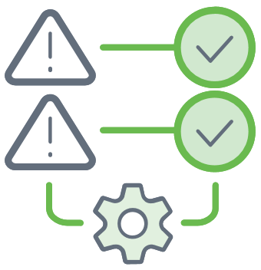
Malware Event
Malware
Event
Phishing
SIEM
UEBA
SOAR

Slide 2
Technical Problems with Security Status Quo
Collection
Detection
Investigation
Response
Ingest
Logs
Centralize
in SIEM
Get Alert
Gather Evidence
Build
Timeline
Respond
to Attack
Problems
Excessive Logging Costs
Can’t Catch Unknown Threats
No Visibility into Distributed Attacks
Poor Tools Require Painstaking Investigation
Manual, Incomplete Response
Exabeam SolutioN
Flat Price Logging
Behavioral
Analysis (UEBA)
Lateral Movement Tracking
Automated Alert Prioritization
Automated Incident Timeline Creation
Orchestrated
Incident Response (SOAR)
Automation
Detection
Investigation
Response
Notes:
The security management status quo also creates significant technical hurdles. We’ve found that most organizations have a security management process that looks something like this. At each step of the process, there are common problems that surface. Each of these problems has a straightforward solution. Next Gen SIEMs may address some mix of these problems. Exabeam has built our next gen SIEM to address all of them.
Excessive logging can be solved with flat pricing
Unknown attacks can be detected with behavioral analysis
Distributed attacks can be uncovered with lateral movement capable of tracking movement across devices, IP addresses, and credentials
Manual investigations can be automated with pre-built incident timelines
Manual response can be automated with security orchestration and automated response ( SOAR)
Now we’ll spend some time talking about the area in the green box. We’ll skip flat pricing because that’s pretty self explanatory.
Considerations:
[Ask the following questions to perform qualification and root out their pain points]
Excessive Logging Costs
What % of logs are you able to store? Are there logs you wish you could store but can’t afford?
How much are your logs growing each year?
How much budget do you set aside for log growth?
Where would you invest money saved from log storage?
Can’t Catch Unknown Threats
What % of threats do you think your team is finding?
Are you happy with the level of visibility you have?
How are you dealing with zero day and other advanced threats?
Lateral Movement Tracking
Can you track credential theft?
How do you discover credential escalation today?
Can you detect lateral movement?
Poor Tools Require Painstaking Investigation
What % of your team’s time is spent on false positives?
How often does an investigation lead to a dead end?
What % of analyst time is spent on clerical, data gathering tasks?
What tool do you use to automate investigations?
What could you do with analysts that were twice as productive?
Manual, Incomplete Response
Do you have any automation in your response today? How much time do you think it saves/could save?
Do you have a repeatable process documented that you can show your auditors?
Do you think you are remediating the entire chain of events, e.g., not just the affected laptop, but the phishing email used to inject the malware?
Have you thought about how a partial response actually causes more remediation costs for the systems you didn’t fix?

